Slide 1

SUPPLY CHAIN MANAGEMENT
Leveraging Data and Analytics for Best Performance
Group – 2
1.Anusha. D. Yellankar
2.Mummanni Kumara Gnanamithra
3.Micah George Salve
4.Abdul Khader R
5.Priyanka R P

Slide 2
INDEX
YOY Sales growth
YTD QTD MTD Sales
Region wise Sales
Top 5 Store wise sales
State wise sales
Product wise sales
Daily Sales Trend
Total Inventory Value and QTY
Screen shots of DASHBOARDS (Excel, Power BI, Tableau)
Screen shot of SQL Queries
Challenges Faced

Slide 3
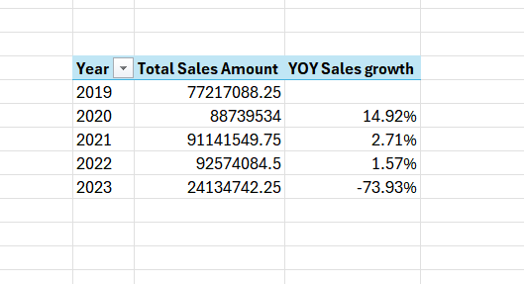
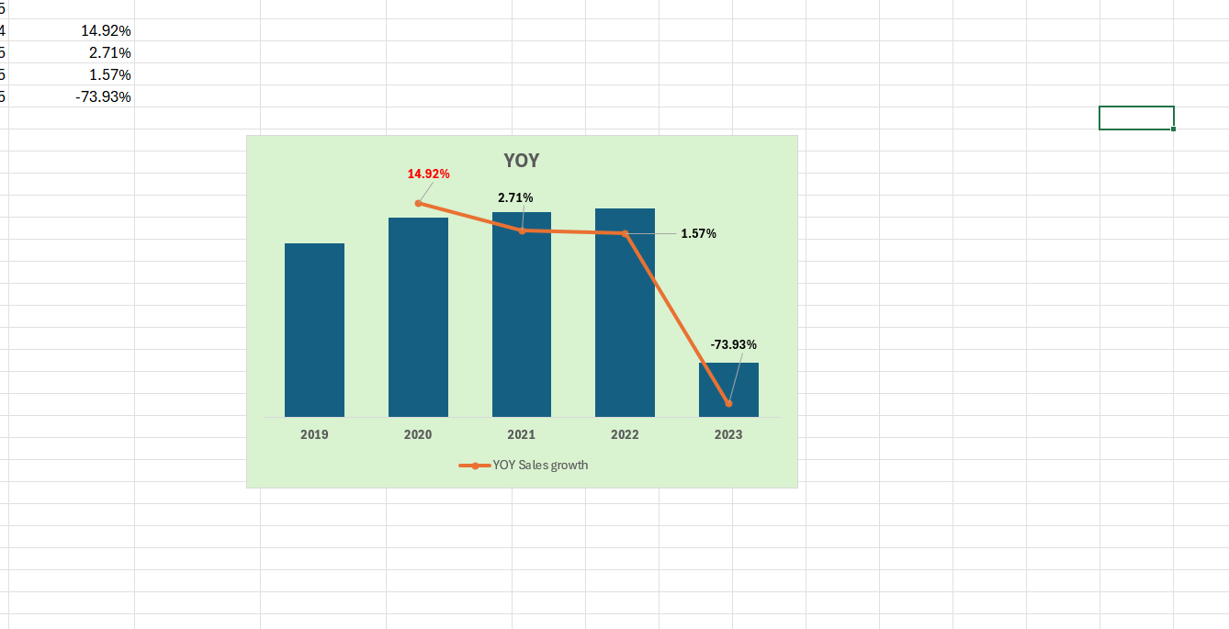
YOY Sales Growth
The company experienced consistent sales growth from 2019 to 2022,because strategies and market conditions were favourable.
The drastic drop in 2023, representing a -73.93% YOY decrease needs to be investigated.
Possible areas to investigate include market conditions, competition, product issues, supply chain disruptions and customer satisfaction.

Slide 4
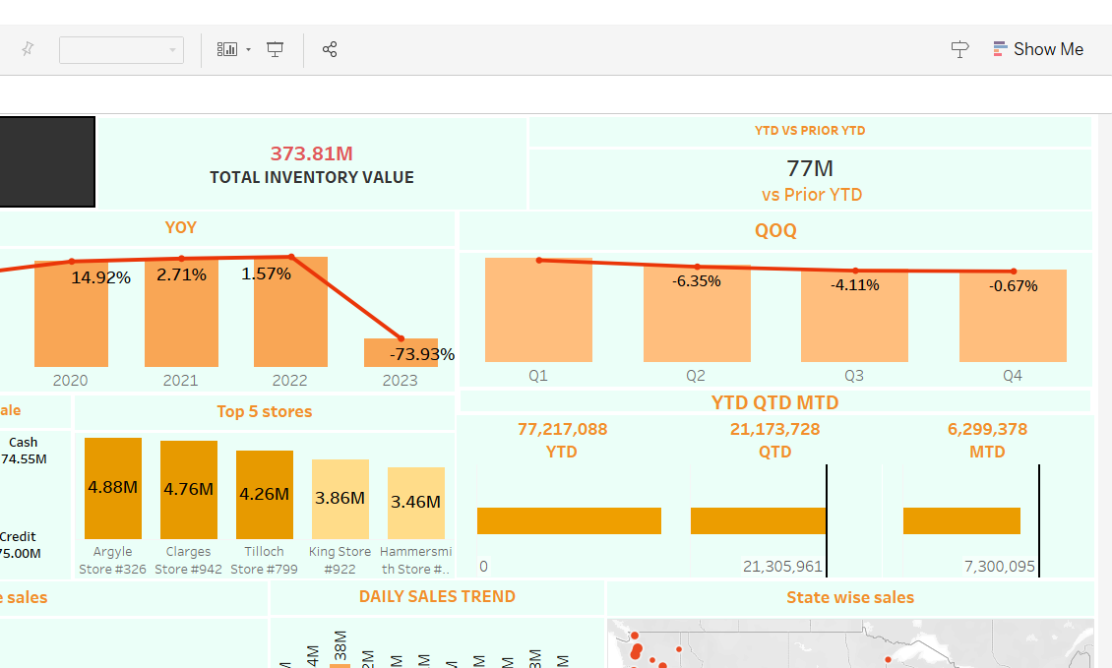
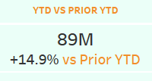



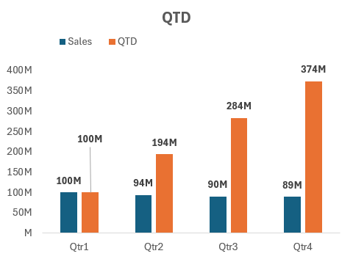
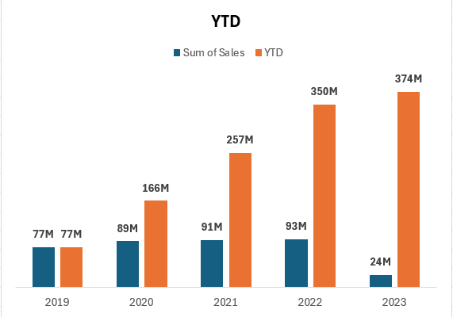
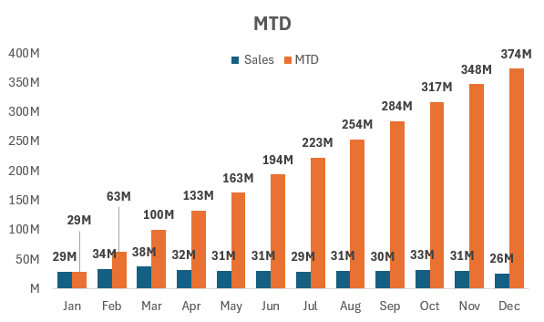
YTD QTD MTD Sales
The sales growth shows a steady upward trend, indicating positive performance and demand.
There is a noticeable deceleration in the growth rate from 2020 to 2021 and 2021 to 2022.
Sales in Early 2023
As of April 6, 2023, the year-to-date sales are $24 million.
This suggests that sales in the first quarter of 2023 are slower compared to previous years, considering the annual totals.
Loss overcome:
Marketing and Promotions.
Discounts and offers.
31-12-2019 :
31-12-2020 :
31-12-2021:
31-12-2022 :
06-04-2023 :

Slide 5
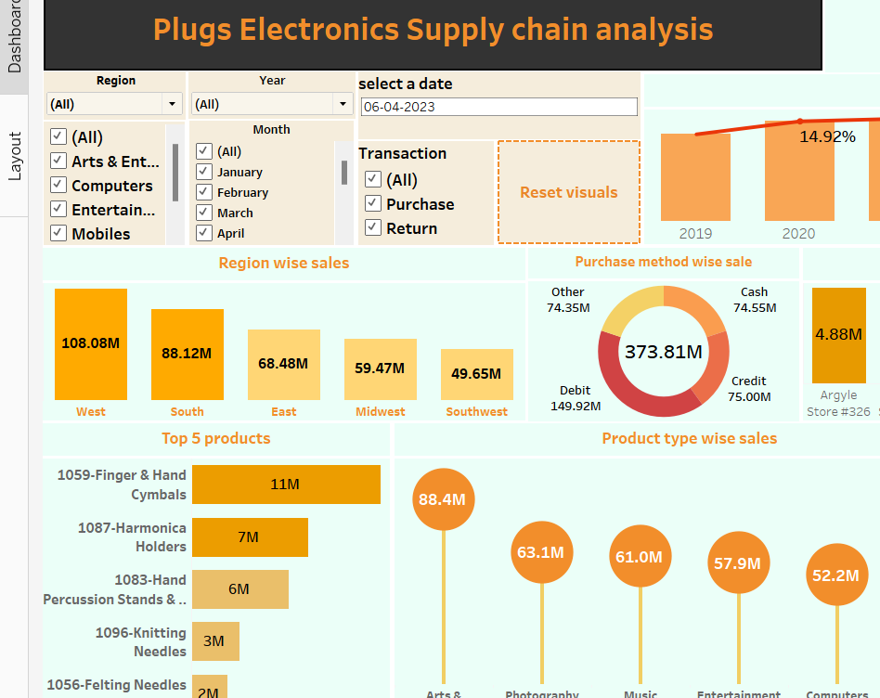
Region wise Sales
Maintaining and possibly enhancing efforts in the West and South regions could yield significant returns due to their high sales performance.
There is potential to increase sales in the East and Midwest regions by analysing and addressing specific market needs and opportunities.
In Southwest region we need to understand the factors contributing to lower sales and develop targeted strategies to boost performance.
Optimize supply chain and logistics to ensure products are readily available and delivered promptly.

Slide 6
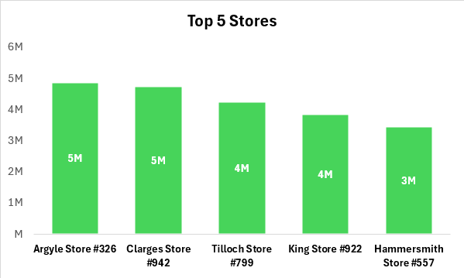
Top 5 Store wise Sales
Argyle Store (#326) and Clarges Store (#942): Both stores lead with sales of 5M each, indicating strong market presence or effective sales strategies. These stores are the top performers in the network.
The middle two stores have identical sales, suggesting similar market conditions or operational efficiencies.
Hammersmith Store (#557): With sales of 3M, this store is the lowest among the top 5 but still significant. There is potential for improvement to match the performance of other top stores.

Slide 7
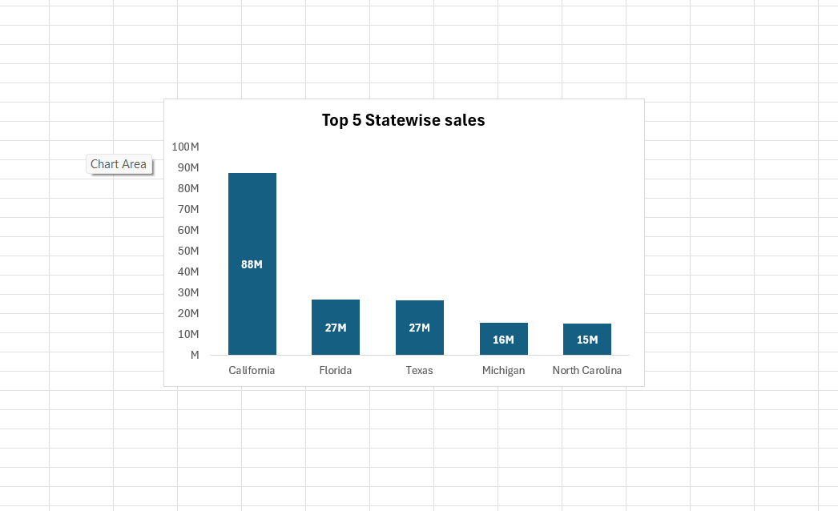
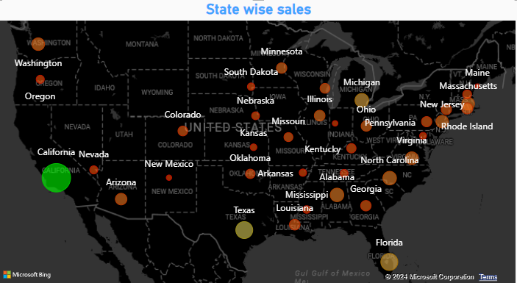
Top 5 State wise Sales
California has the highest sales of 88 million .we need to maintain and possibly increasing efforts .By investing more in marketing or product availability in this state.
Design specific promotions in Florida and Texas to boost sales further.
Conduct detailed market research to understand the factors affecting sales in Michigan and North Carolina states .

Slide 8
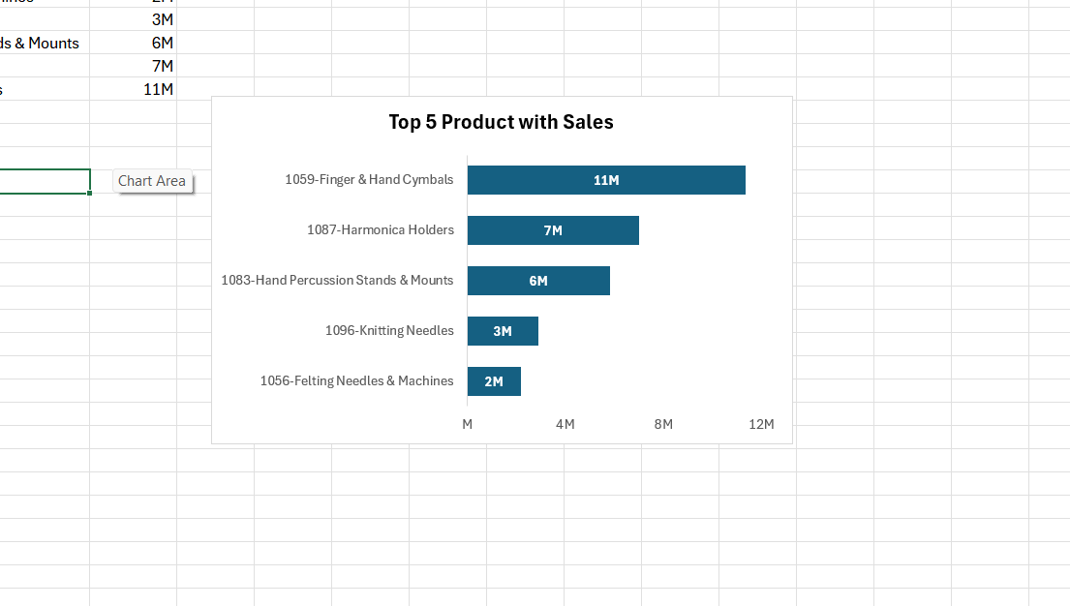
Top 5 Products Sales
1059-Finger & Han Cymbals : Achieved the highest sales at 11M, indicating strong market demand and effective marketing strategies.
1087-Harmonica Holders & 1083-Hand Percussion Stands & Mounts showcasing a robust market presence and possibly a unique appeal to customers & reflecting consistent demand and customer preference.
1096-Knitting Needles : Sales of 3M suggest moderate performance with room for growth through targeted initiatives.
1056-Felting Needles & Machines : With 2M in sales, this product is the lowest among the top 5, highlighting the need for strategic improvements to boost performance.

Slide 9
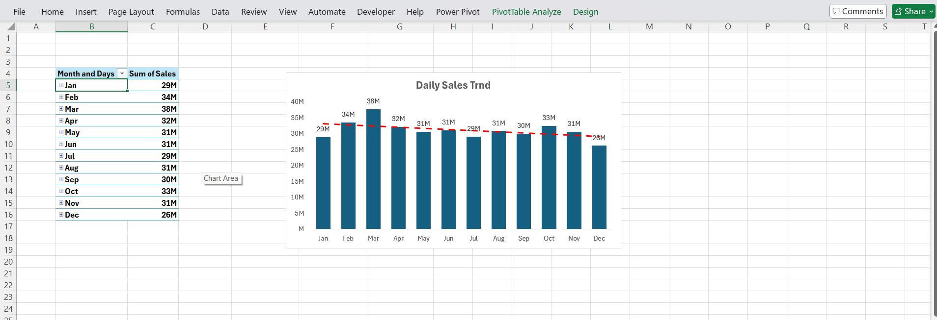
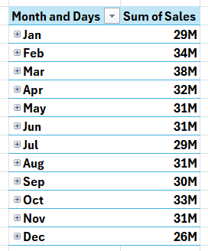
Daily Sales Trend
The sales trend shows relative consistency, with monthly sales generally ranging between 29M and 34M.
Highest Sales month is March with 38M.
Consistently High Sales : February, April, and October , Each recorded sales of 34M, 32M, and 33M, respectively.
Lowest Sales month is Decembere with 26M. The decline in sales during December could be due to various factors like market saturation or seasonal downturns

Slide 10




Total Inventory value and QTY
Conduct market analysis to understand customer preferences and adjust inventory stocking to align with demand.
A large volume of inventory has been successfully sold, showing strong sales performance
Continuous monitoring of inventory levels and sales performance is essential for sustained success.

Slide 11
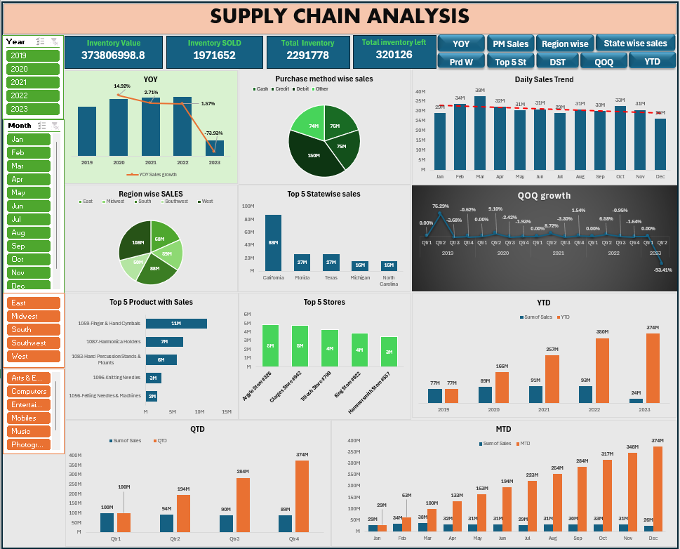
EXCEL DASHBOARD

Slide 12
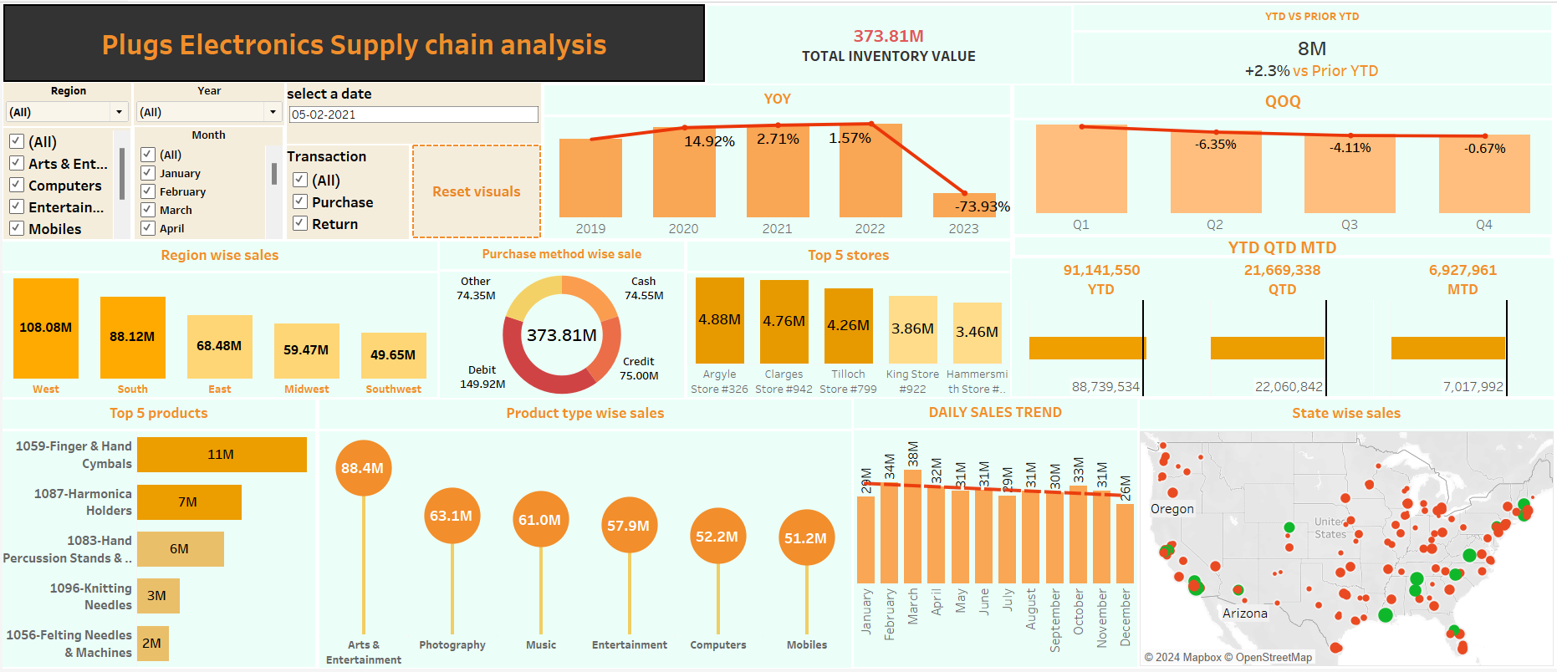
TABLEAU DASHBOARD

Slide 13
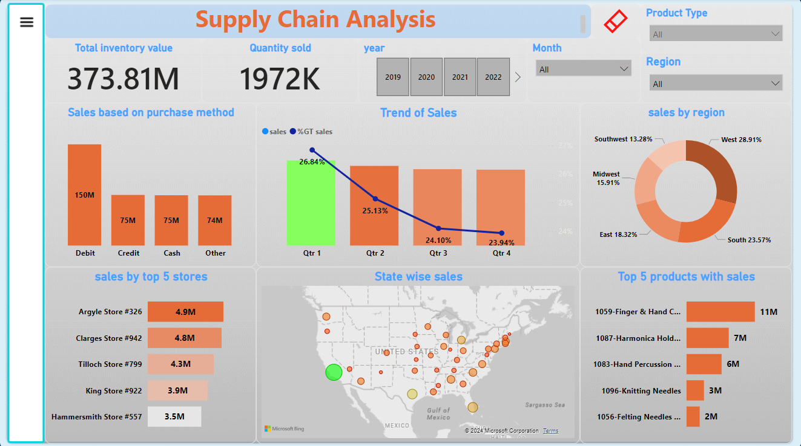
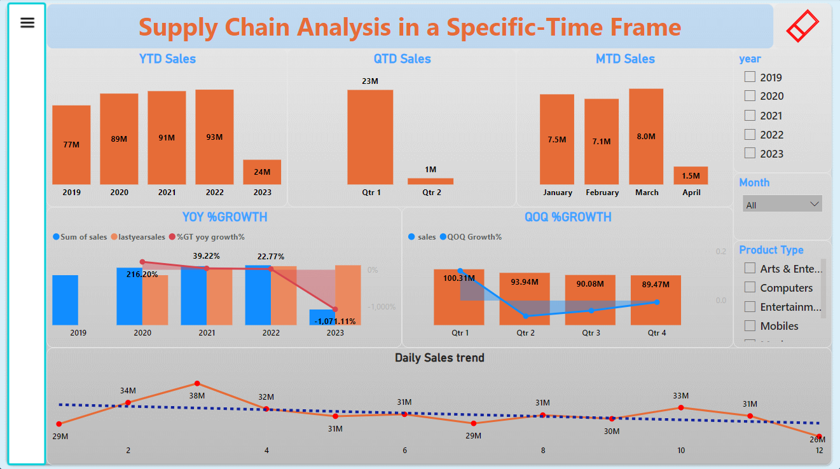
POWER BI DASHBOARD

Slide 14
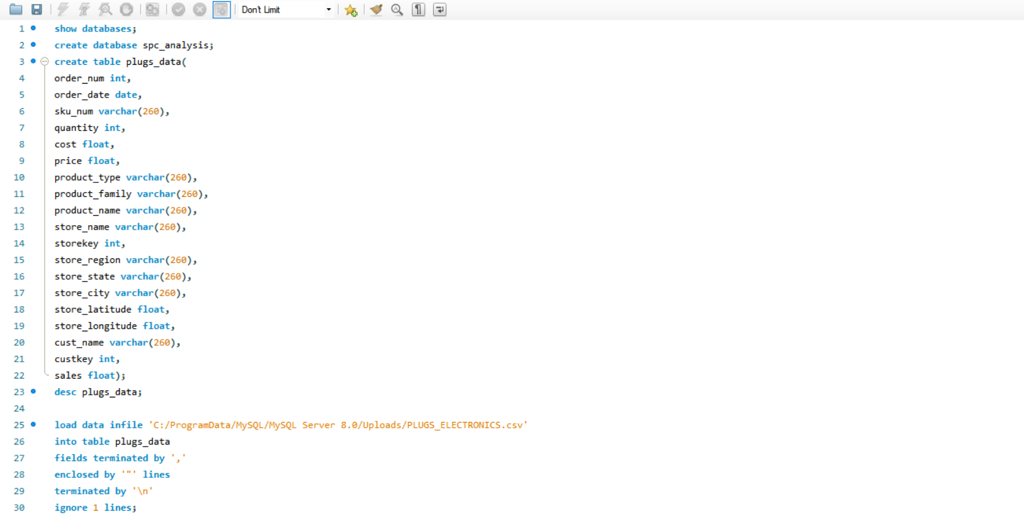
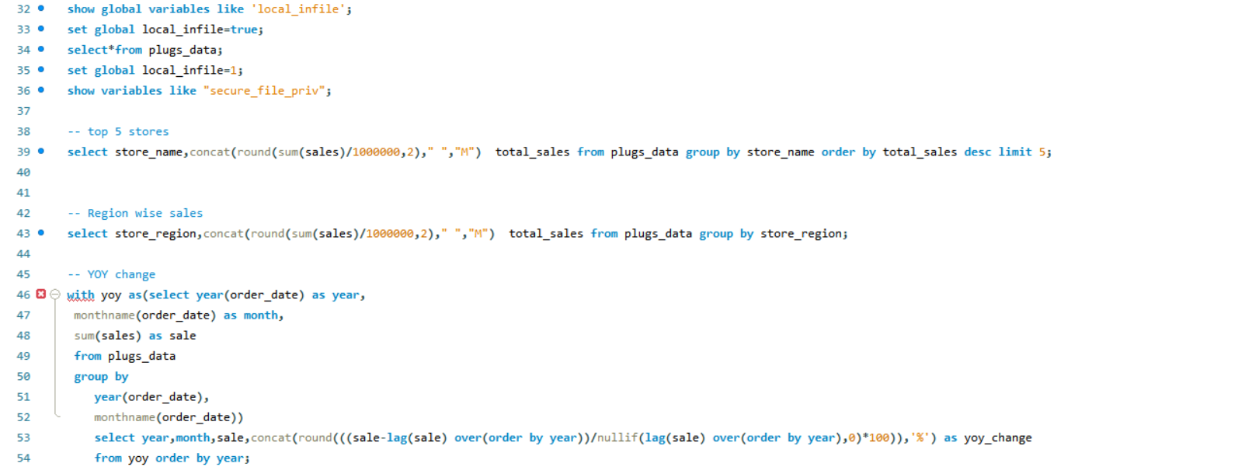
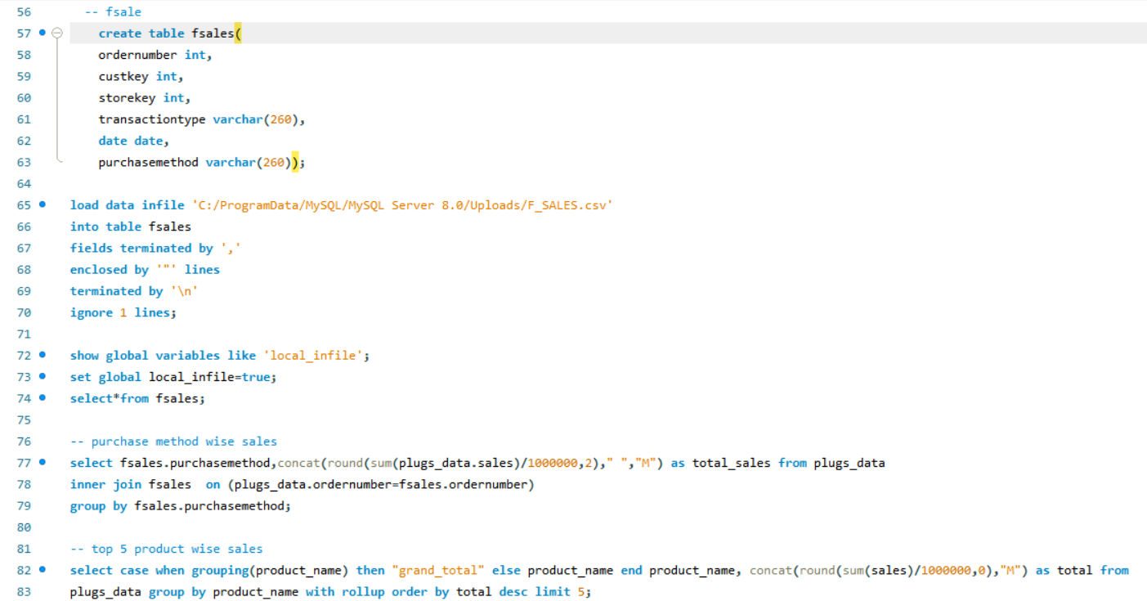
SQL Queries

Slide 15
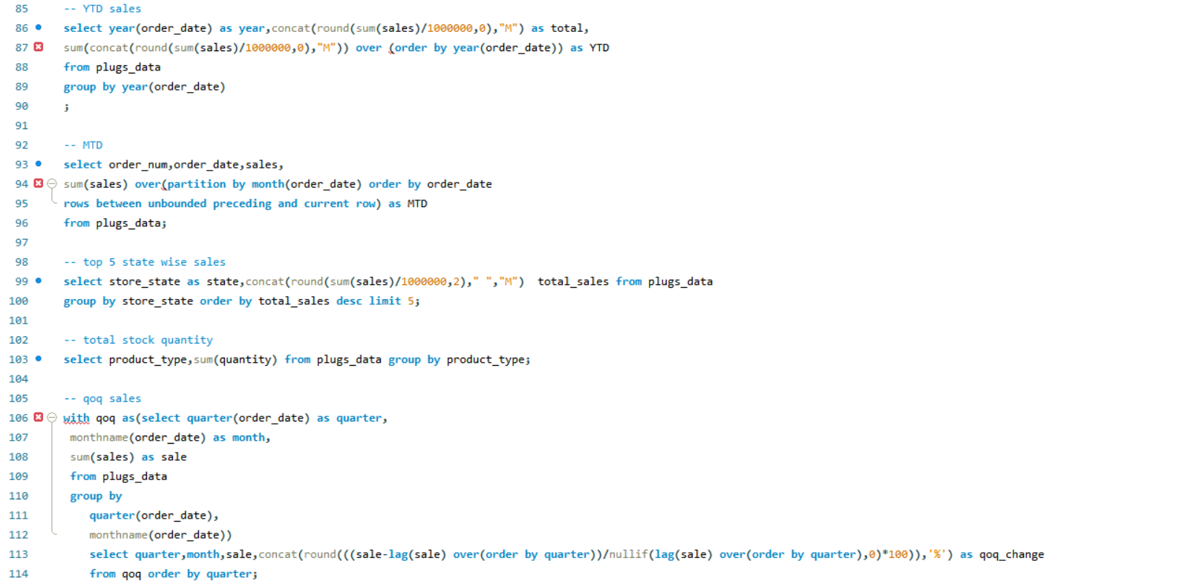
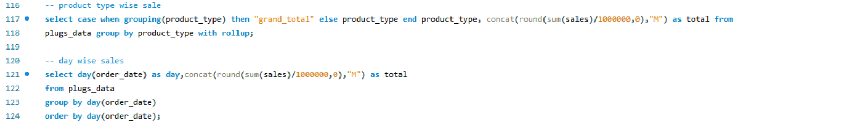

Slide 16
Challenges Faced While Analysing The Data
Data Integration and Quality
Integrating data from various sources and ensuring the accuracy, consistency, and completeness of the data. Poor data quality can lead to incorrect analysis and decision-making, impacting the overall efficiency of the supply chain.
Scalability
Managing and analyzing large volumes of data efficiently.
Data Cleaning
Handling missing values, duplicates, and errors in the dataset.
Data Interpretation
Correctly interpreting data trends and patterns.
Data Visualization
Creating clear and effective visualizations to communicate findings.
Time Constraints
Meeting tight deadlines while ensuring thorough analysis.

